Slide 1
Graphs for NLP
Yogesh Kulkarni

Slide 2
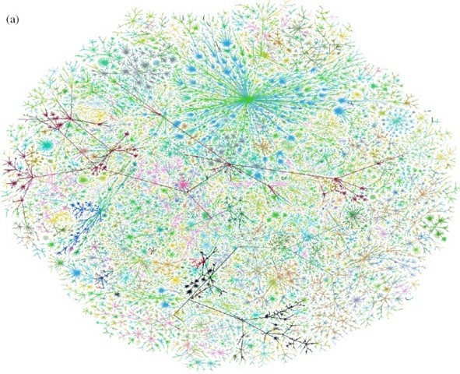
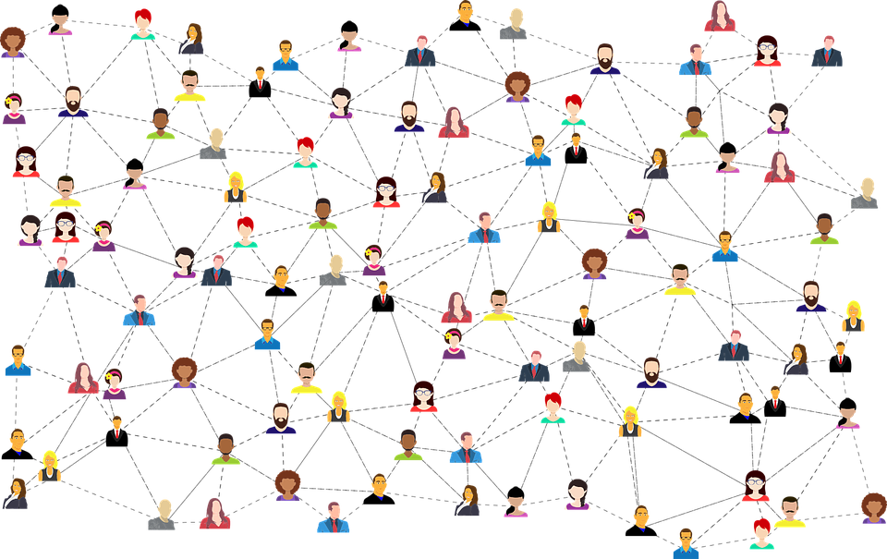
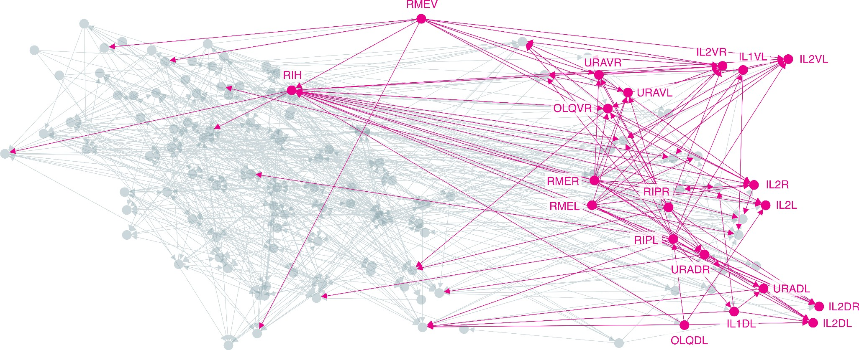
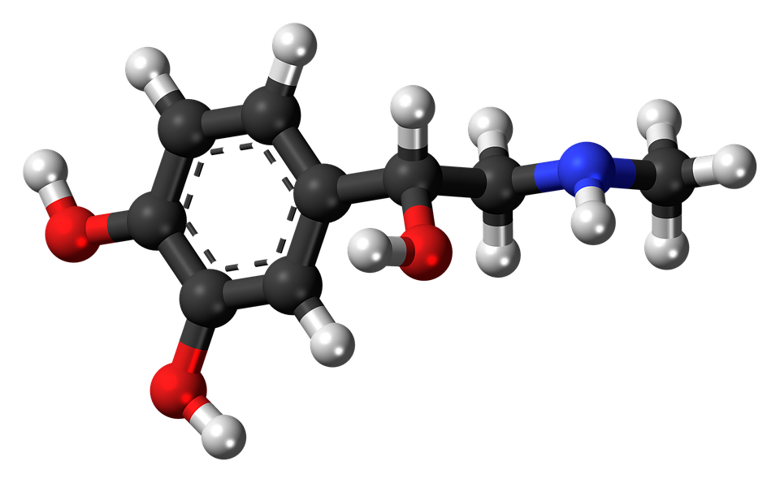
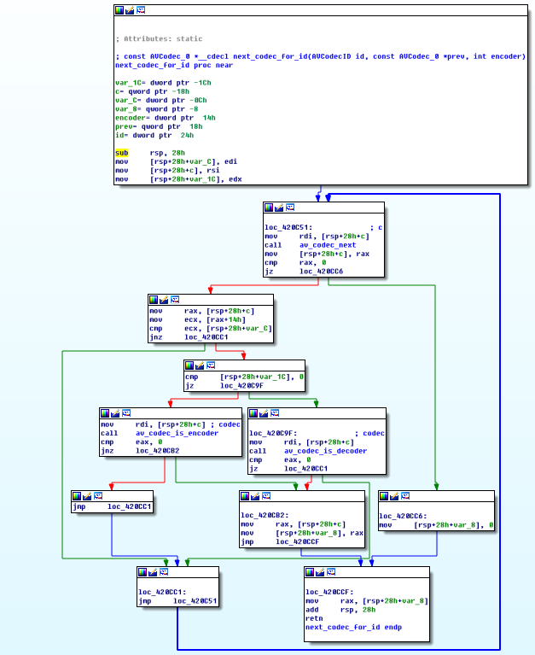
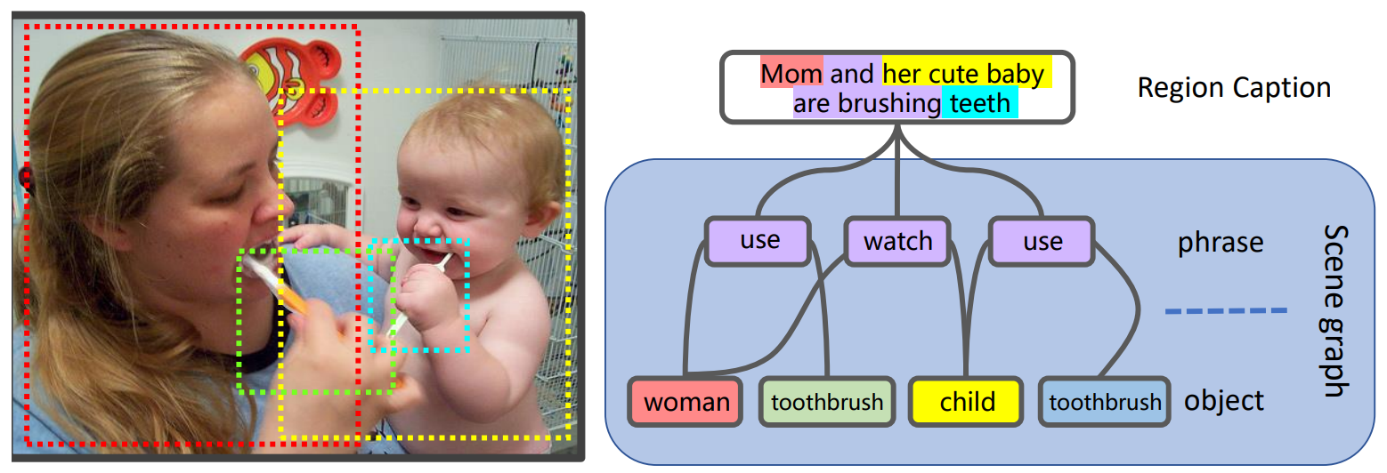
Graph-structured Data Are Ubiquitous
Internet
Social networks
Networks of neurons
Biomedical graphs
Scene graphs
Program graphs

Slide 3
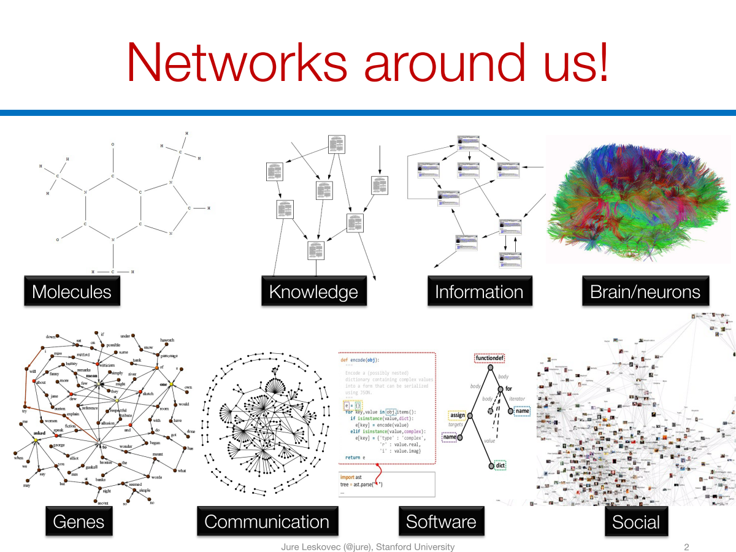

Slide 4
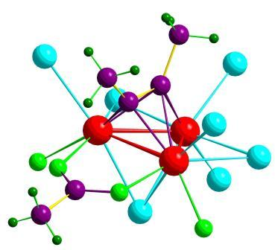
Data as Graphs - Explicit
Social Graphs
Transportation Graphs
Brain Graphs
Web Graphs
Molecular Graphs
Gene Graphs

Slide 5
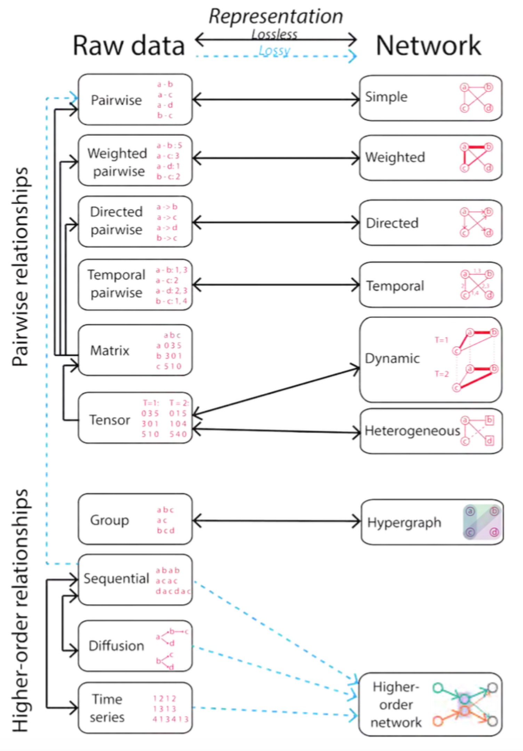

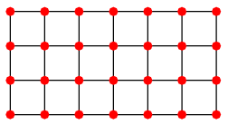
Data as Graphs - Implicit
Jian Xu. Representing Big Data as Networks. PhD Dissertation, University of Notre Dame

Slide 6
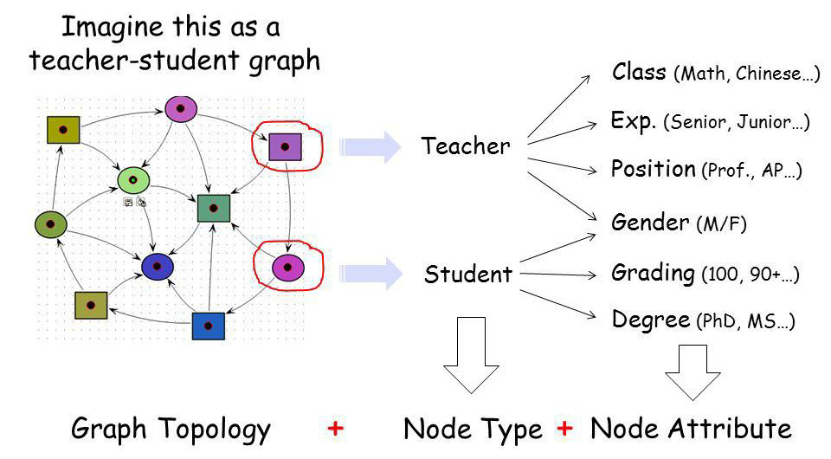
Graphs: A Universal Language
Graphs are a general language for describing and modeling complex systems
Graph!

Slide 7
Graphs and features
Graph Signal:

Slide 8
Why Graphs? Why Now?
Universal language for describing complex data
Networks/graphs from science, nature, and technology are more similar than one would expect
Shared vocabulary between fields
Computer Science, Social science, Physics, Biology, Economics
Data availability (+ computational challenges)
Social/internet, text, logic, program, bio, health, and medical
Impact
Social networking, Social media, Drug design, Event detection, Natural language processing, Computer vision, and Logic reasoning

Slide 9
Traditional graph learning approaches
Generate embeddings by manual feature engineering
Requires domain expertise, involves considerable manual fine-tuning, time consuming, does not scale, …
Automatically generate embeddings using unsupervised dimensionality reduction approaches
Singular value decomposition, tensor decomposition, co-factorization, deep walks, etc.
Cannot effectively combine rich attributes with network structure.
Employ mostly (multi-)liner models.
Do not allow for end-to-end learning.

Slide 10
ML in graph learning
Node classification
Detect malicious accounts
Target right customers
Link prediction
Recommendations
Predict missing relations in a knowledge graph
Graph classification
Predict the property of a chemical compound

Slide 11
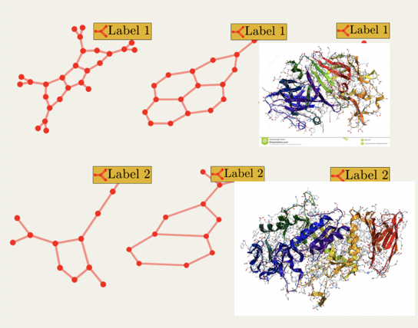
Tasks on Graph-Structured Data
Node-level
Graph-level
Link Prediction
Graph Classification
？
？
t
t+a
Node Classification
？
？
？

Slide 12
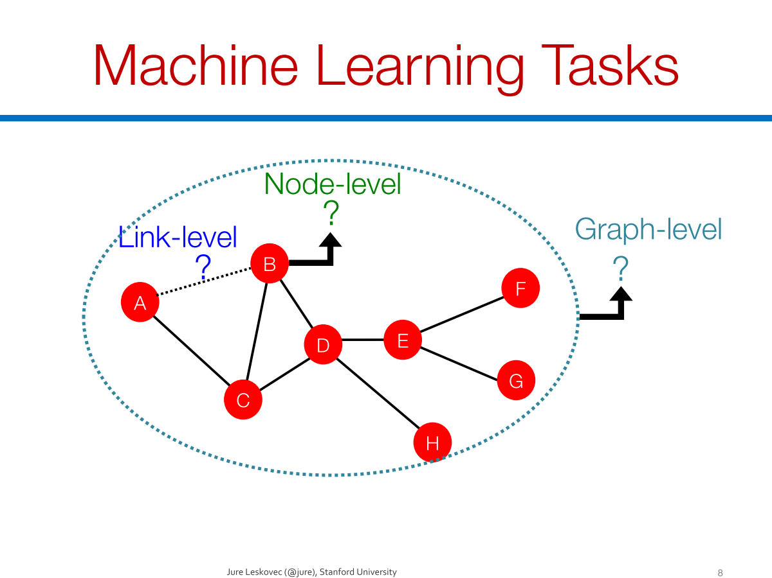

Slide 13
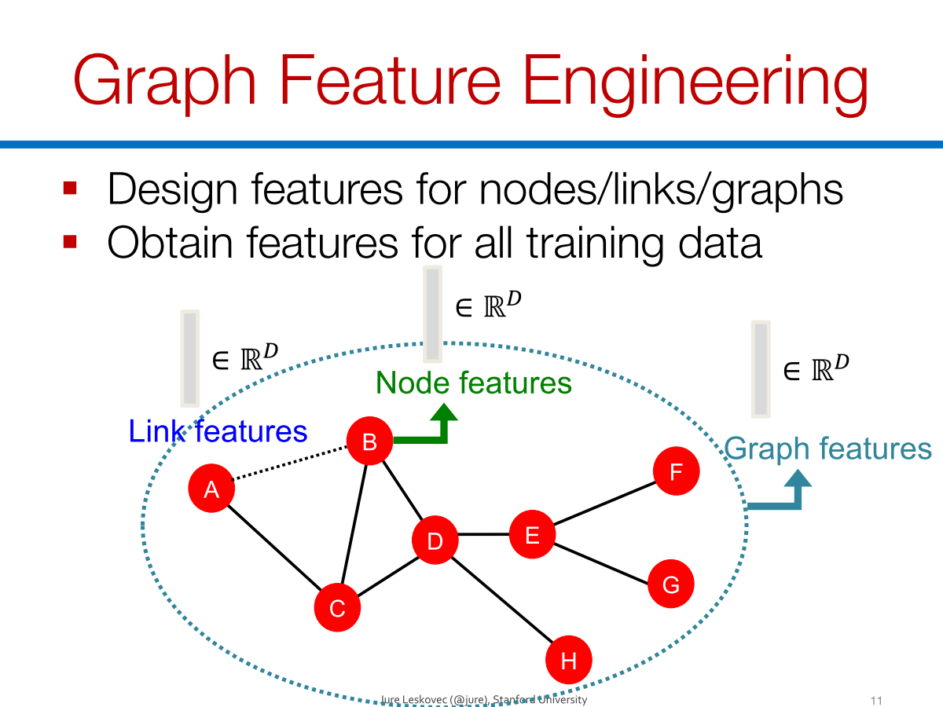

Slide 14
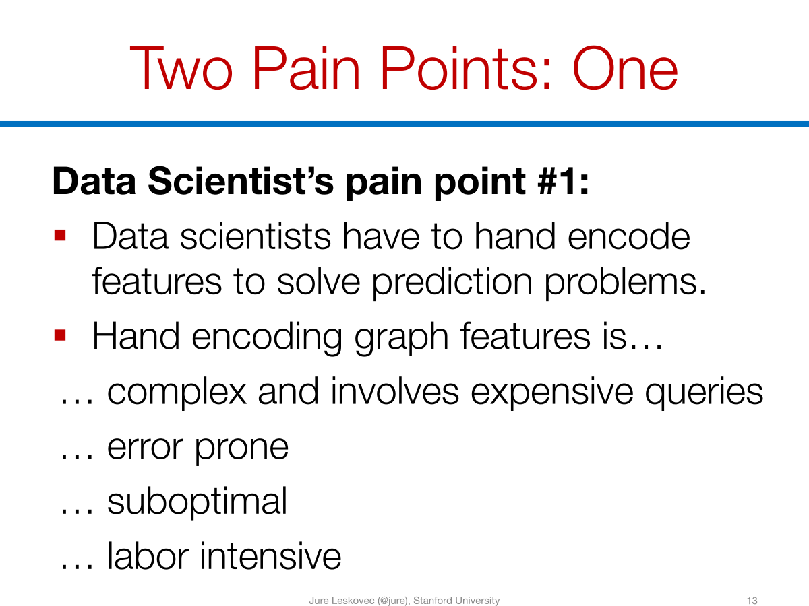

Slide 15
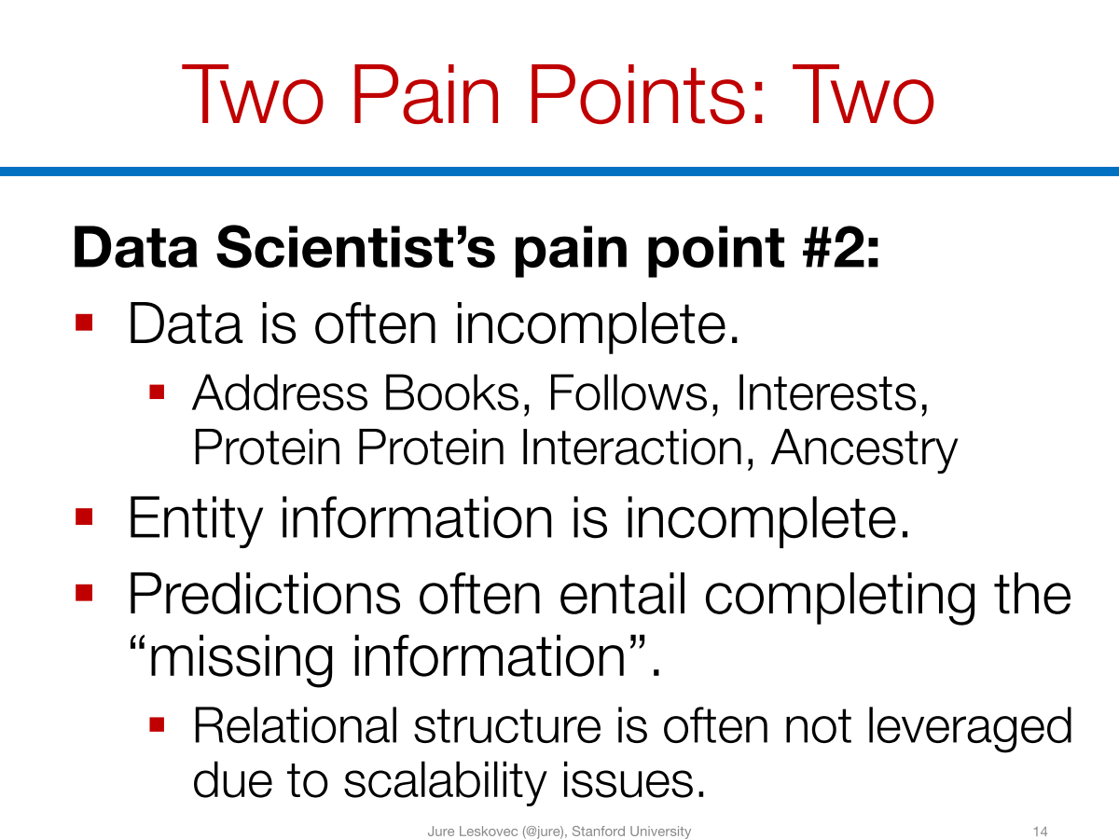

Slide 16
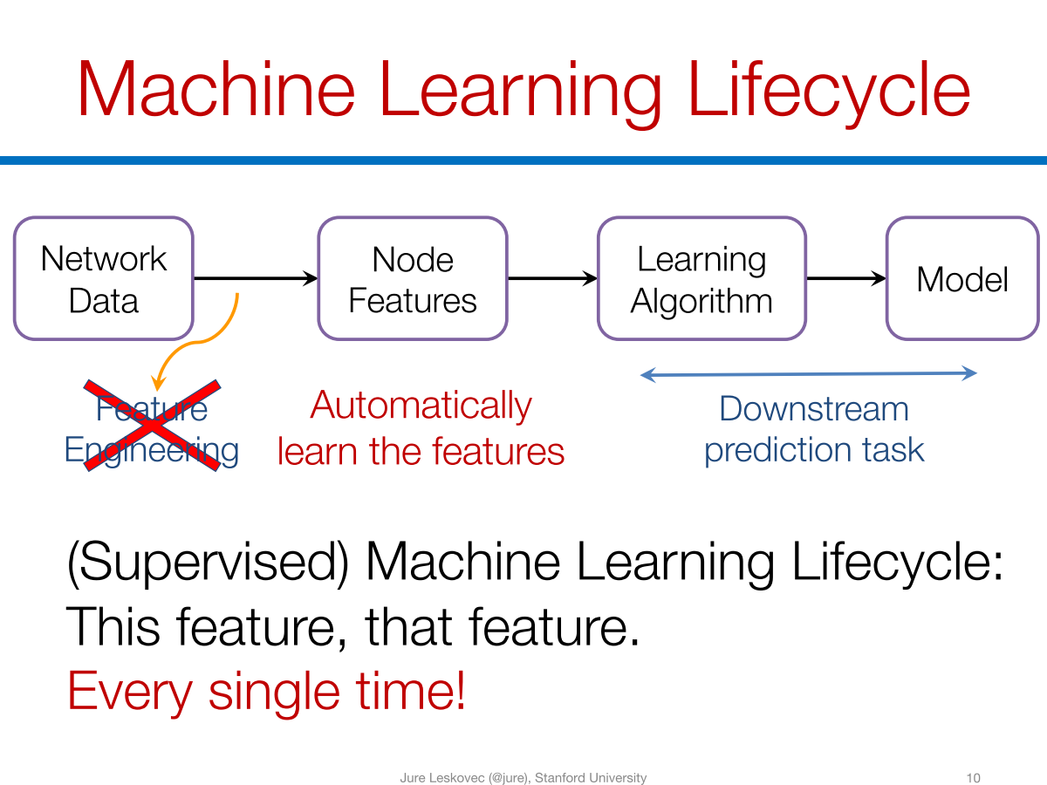

Slide 17
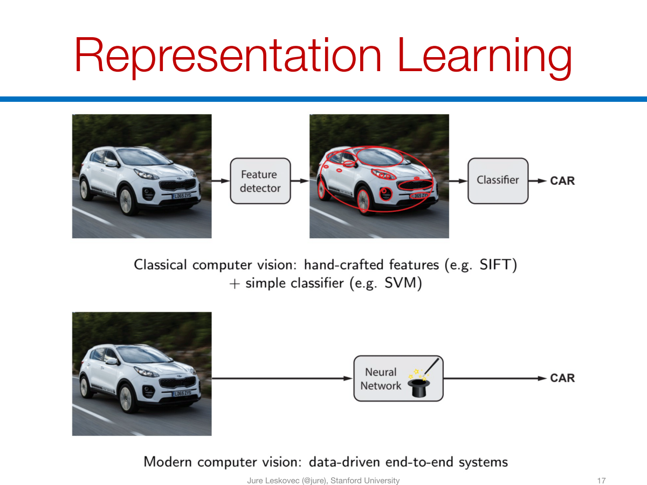

Slide 18
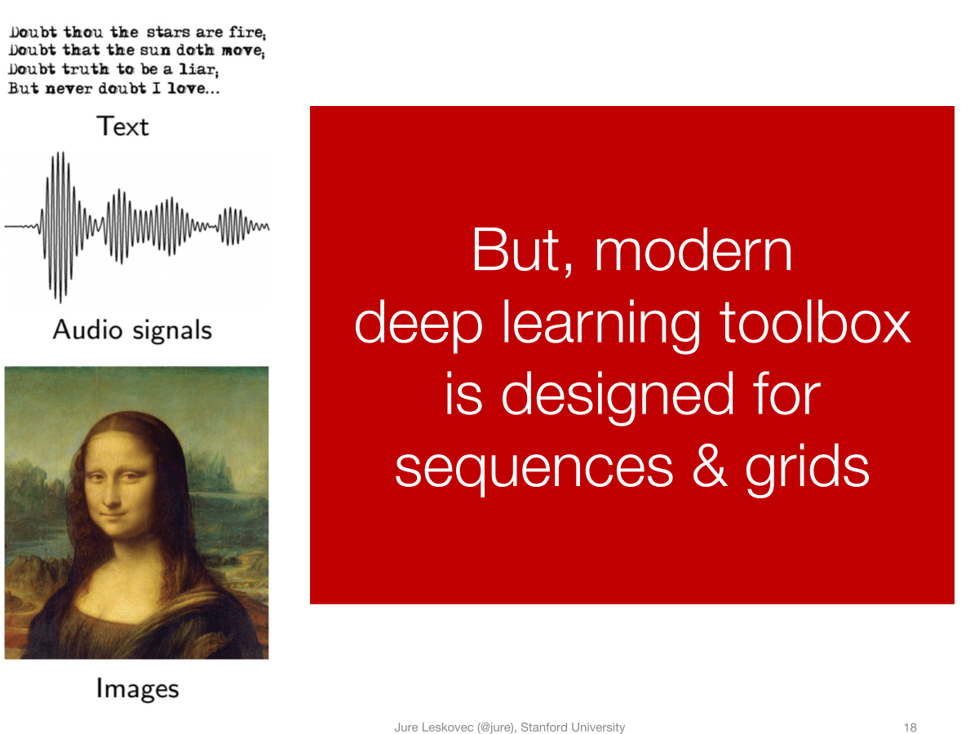

Slide 19
Deep Learning Meets Graphs: Challenges
Traditional DL is designed for simple grids or sequences
CNNs for fixed-size images/grids
RNNs for text/sequences
But nodes on graphs have different connections
Arbitrary neighbor size
Complex topological structure
No fixed node ordering

Slide 20
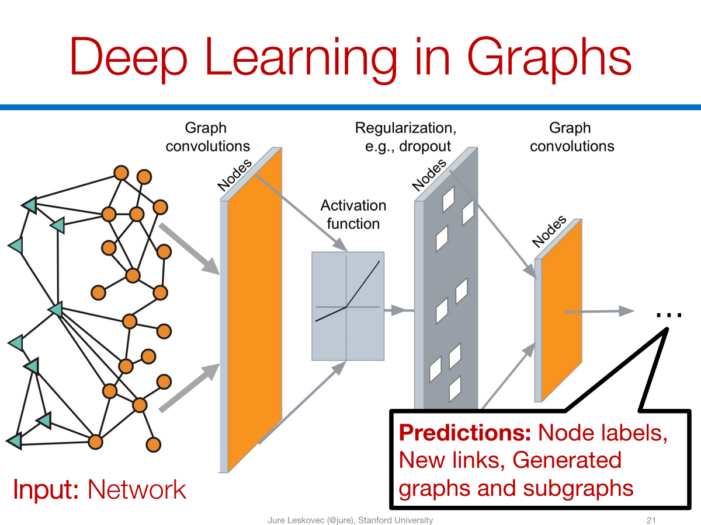

Slide 21
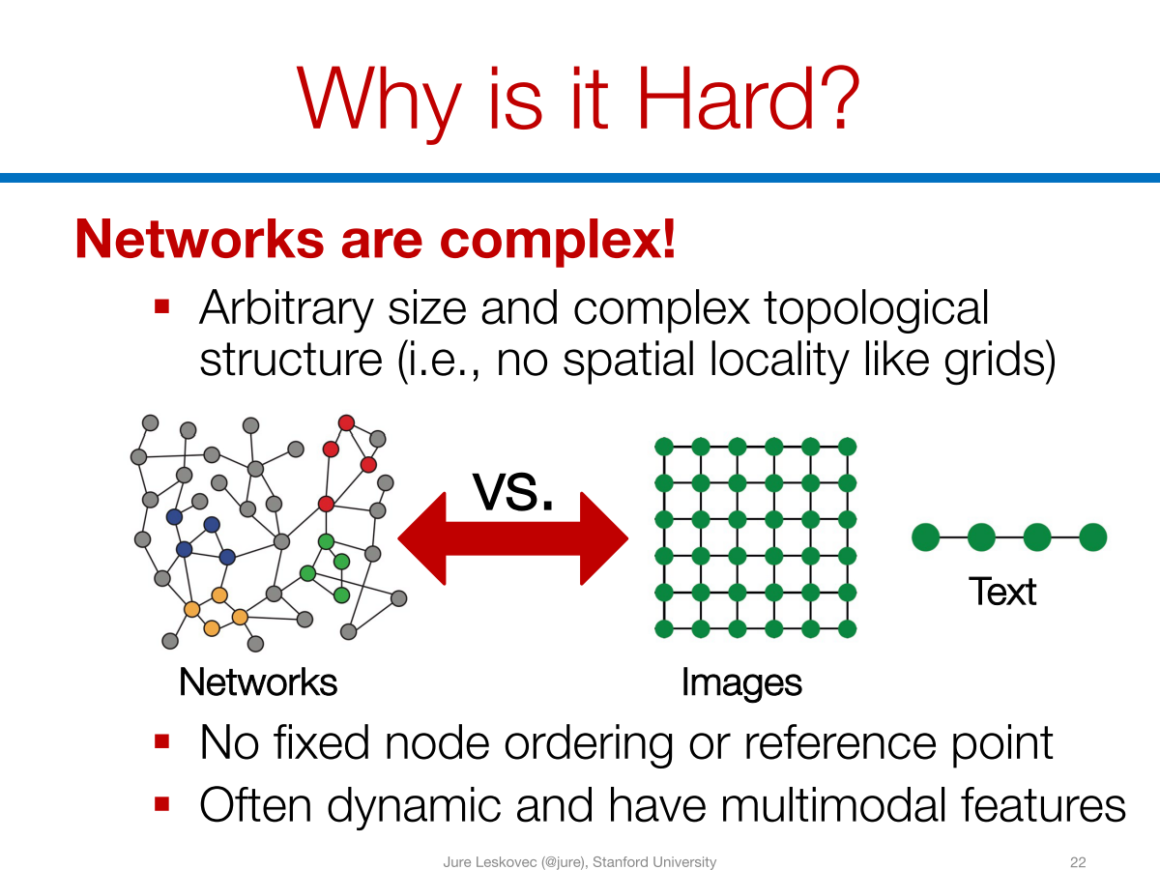

Slide 22
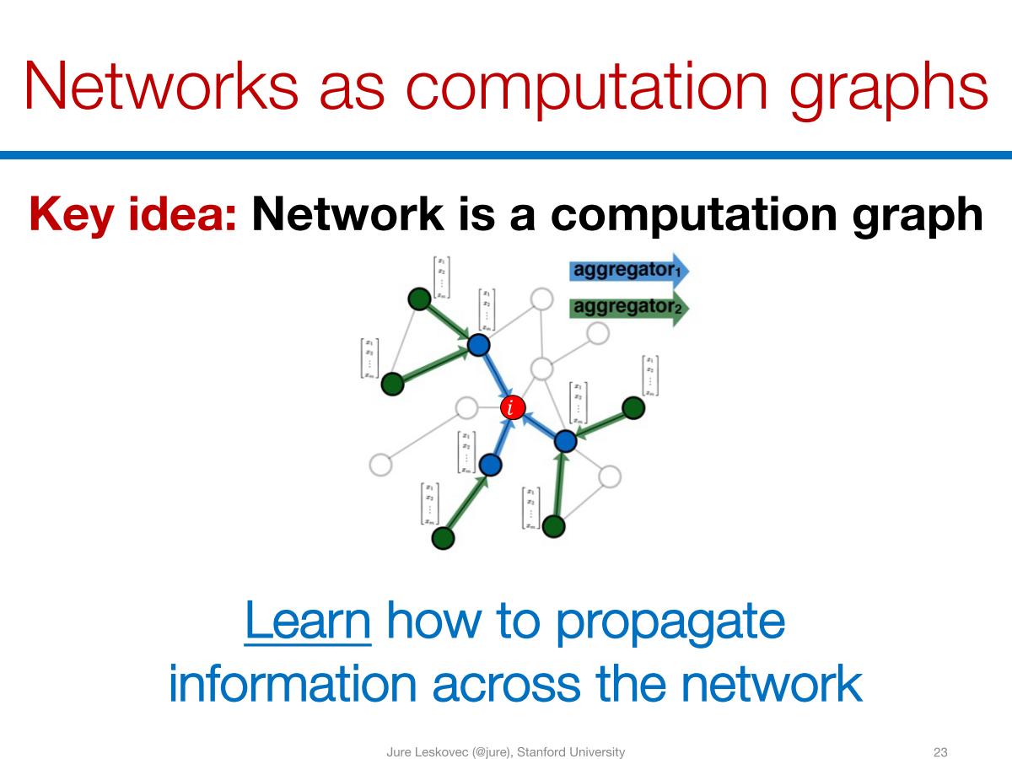

Slide 23

Graph Neural Networks
Representations
Graph-level
Activation Function
Node-level
Graph Convolutions
Graph Convolutions

Slide 24

Machine(Deep) Learning with Graphs
Classical ML tasks in graphs:
Node classification
Predict a type of a given node
Link prediction
Predict whether two nodes are linked
Community detection
Identify densely linked clusters of nodes
Graph similarity
How similar are two (sub)graphs
Recent ML tasks in graphs:
Graph classification
Predict a type of a given graph
Graph generation
Generate graphs from learned distribution
Graph structure learning
Identify densely linked clusters of nodes
Graph-to-XXX learning
Graph Inputs – XXX outputs

Slide 25
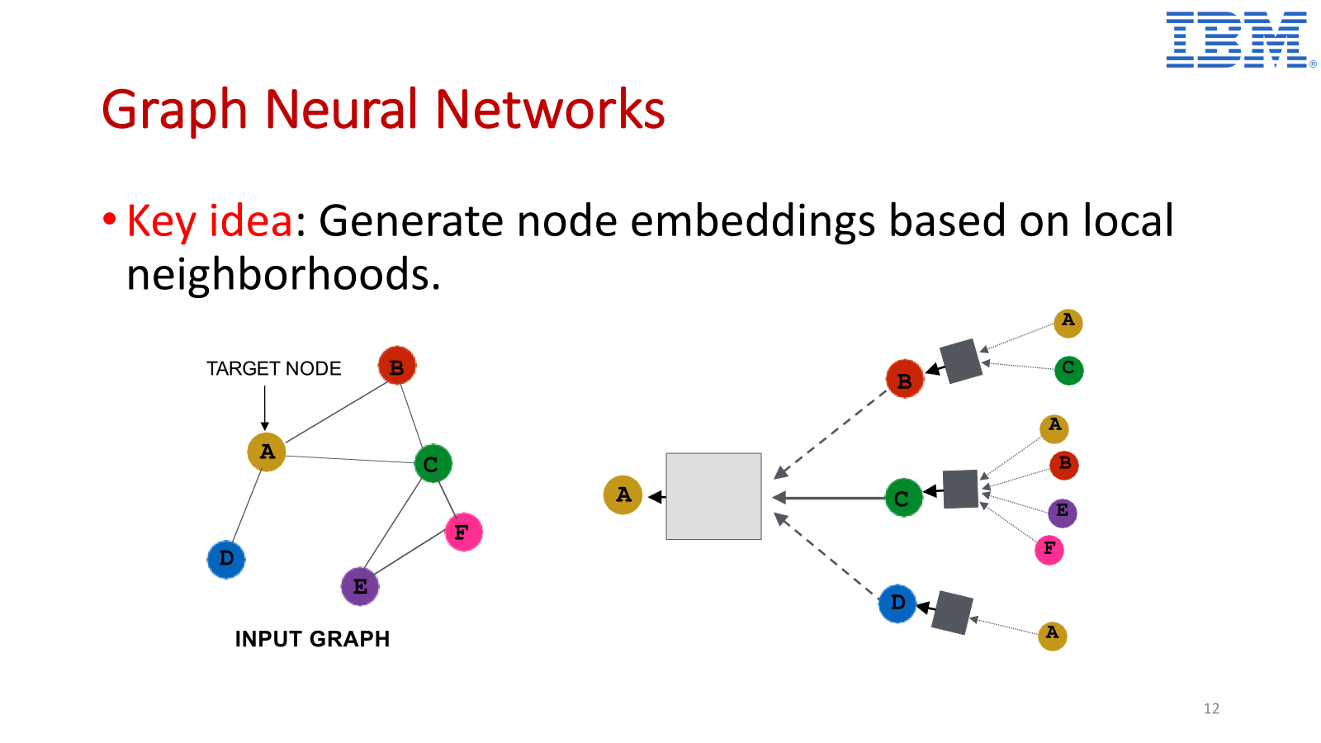

Slide 26
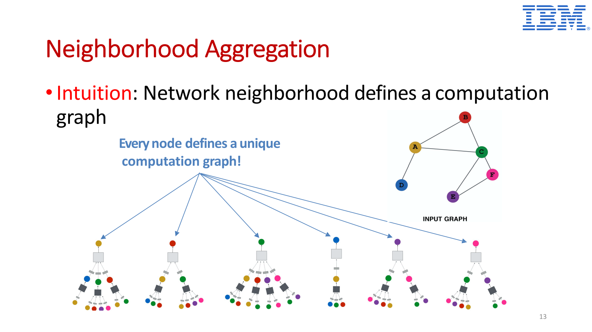

Slide 27
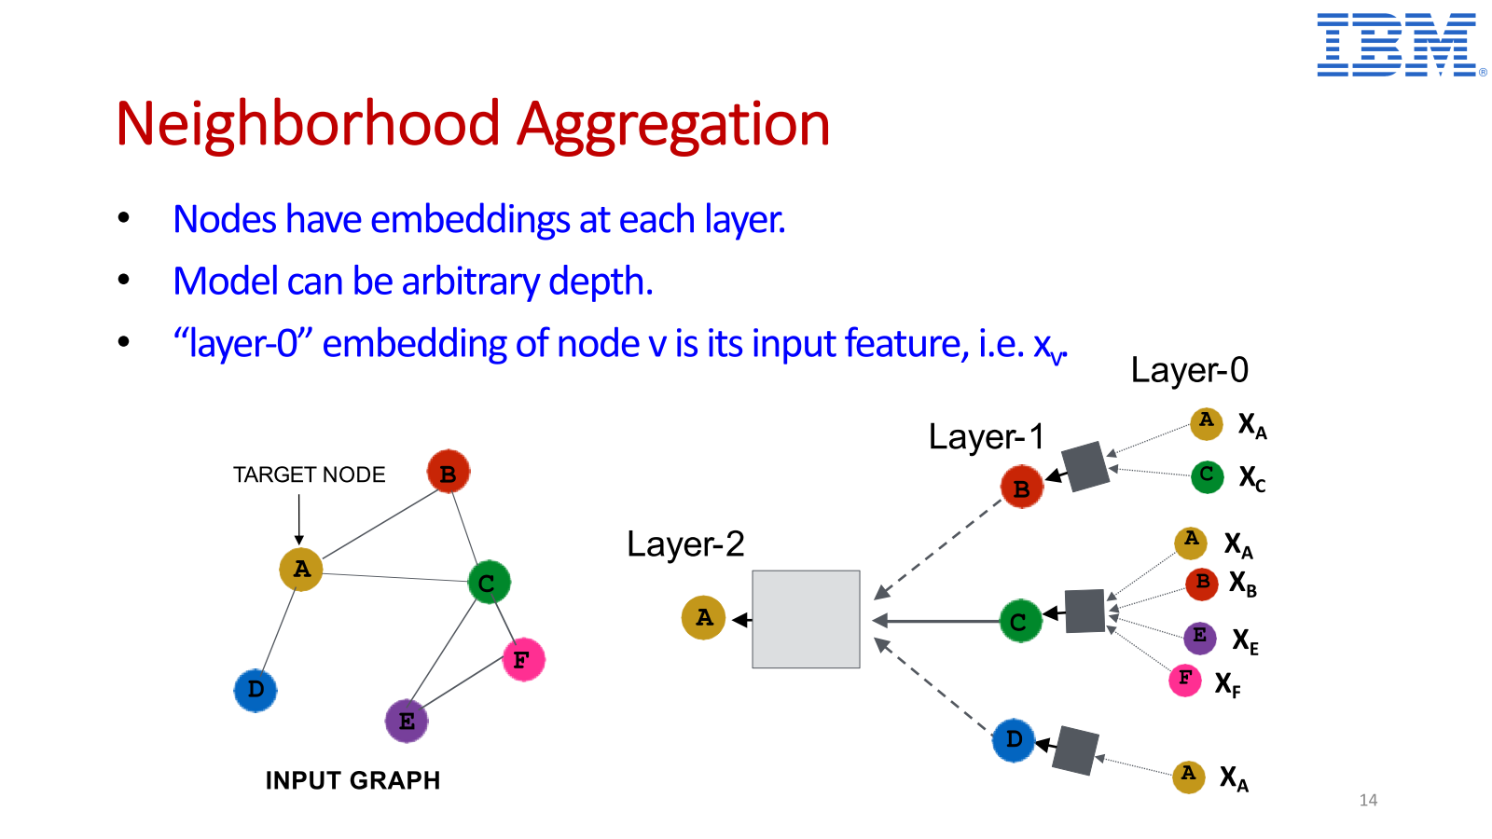

Slide 28
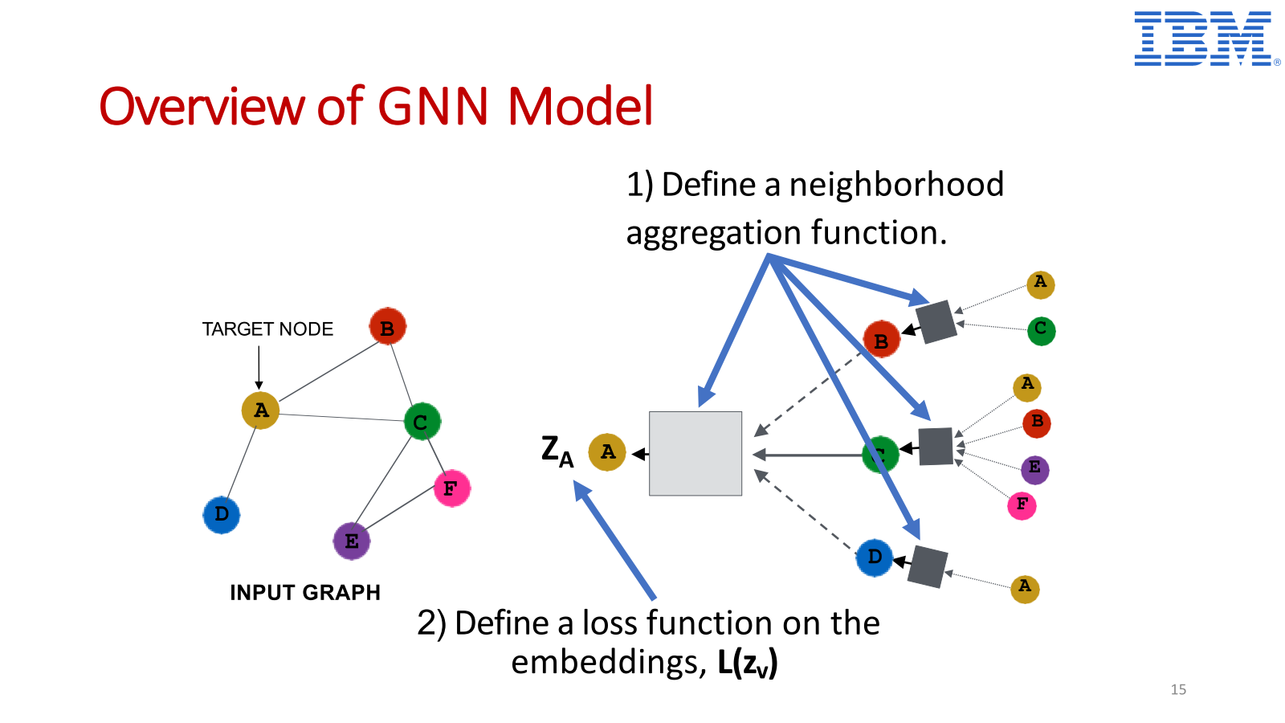

Slide 29
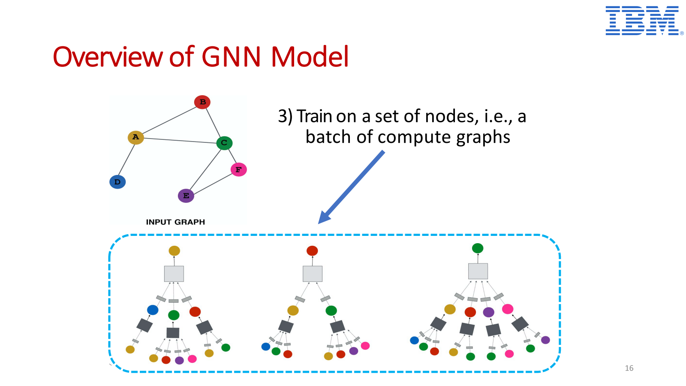

Slide 30
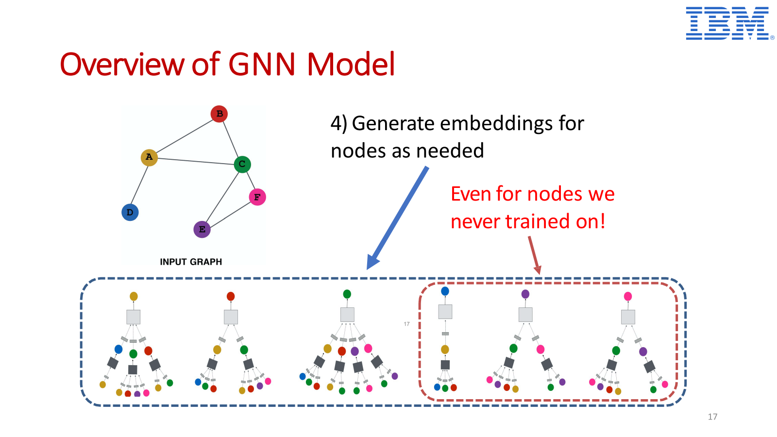

Slide 31
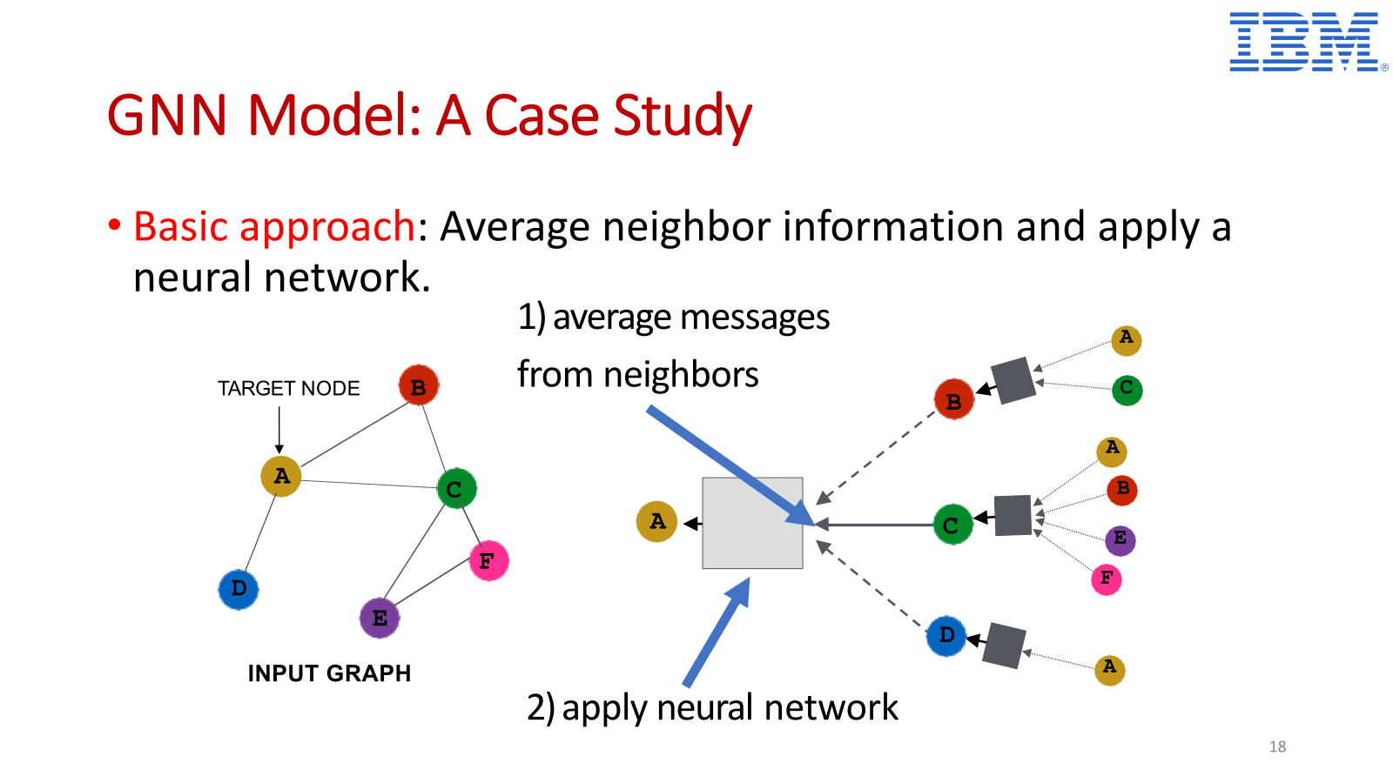

Slide 32
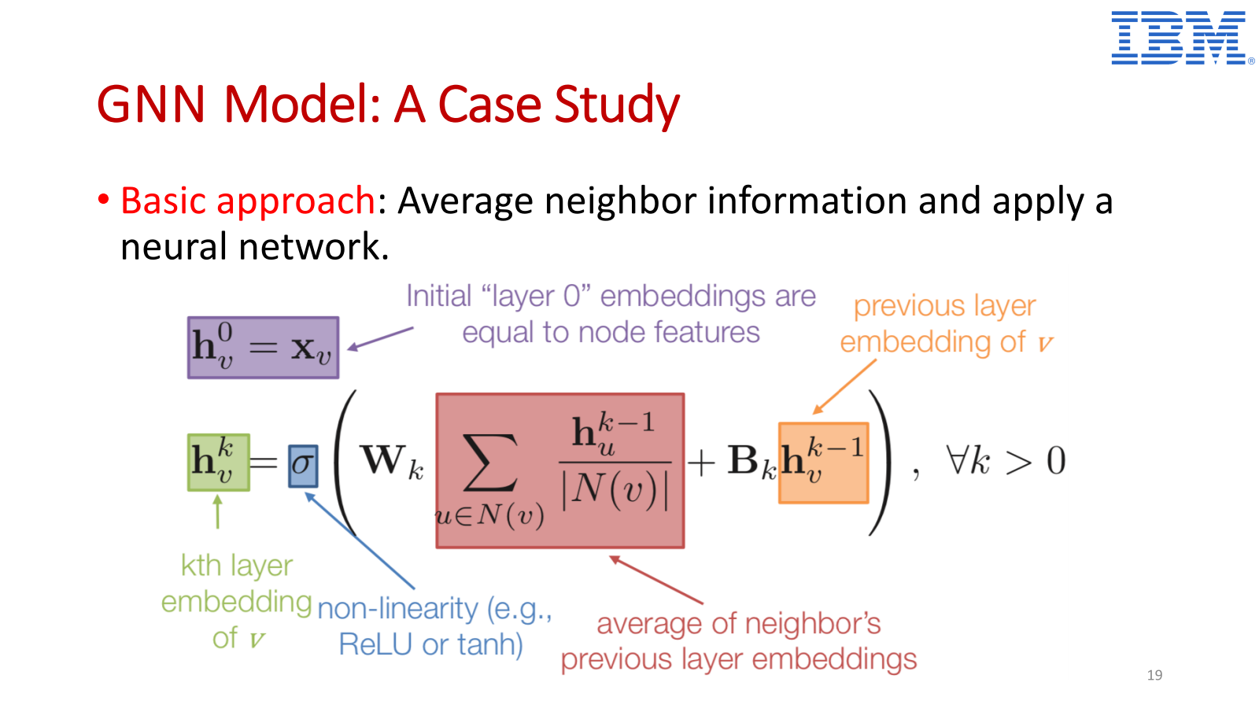

Slide 33
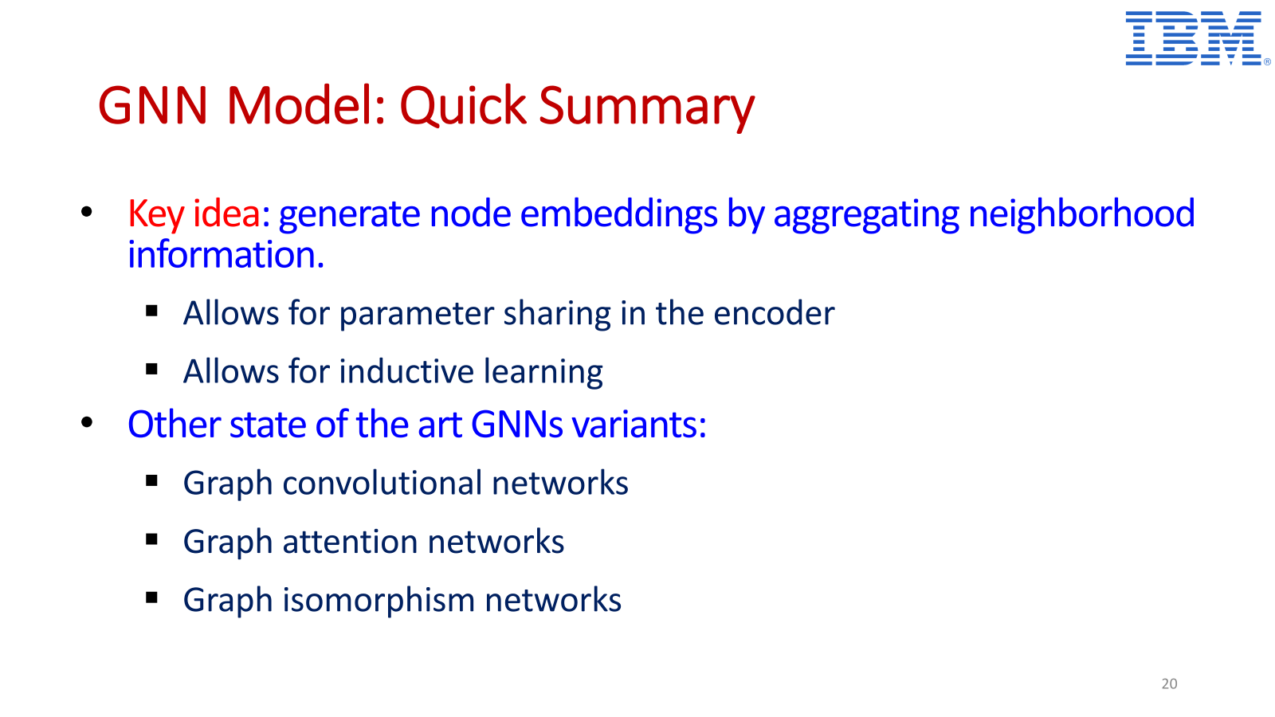

Slide 34
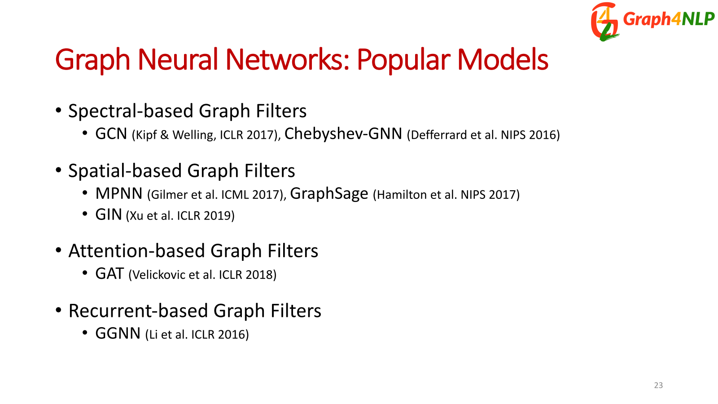

Slide 35
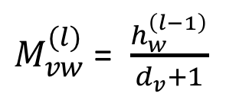
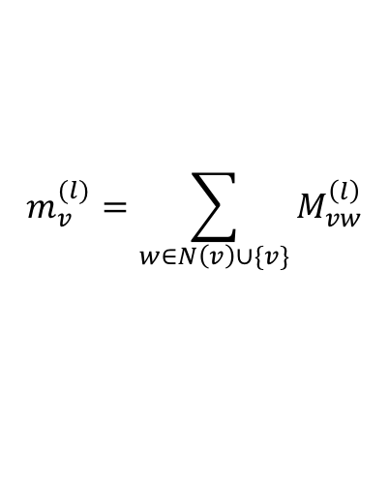
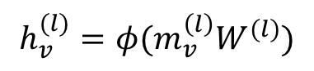
Example 1: Graph convolution network (GCN)
$M_{vw}^{(l)}$= $\frac{h_{w}^{\left(l−1\right)}}{d_{v}+1}$
$$m_{v}^{(l)}=\sum_{w∈N\left(v\right)∪\{v\}}{M_{vw}^{\left(l\right)}}$$
$$h_{v}^{(l)}=φ(m_{v}^{\left(l\right)}W^{(l)})$$

Slide 36
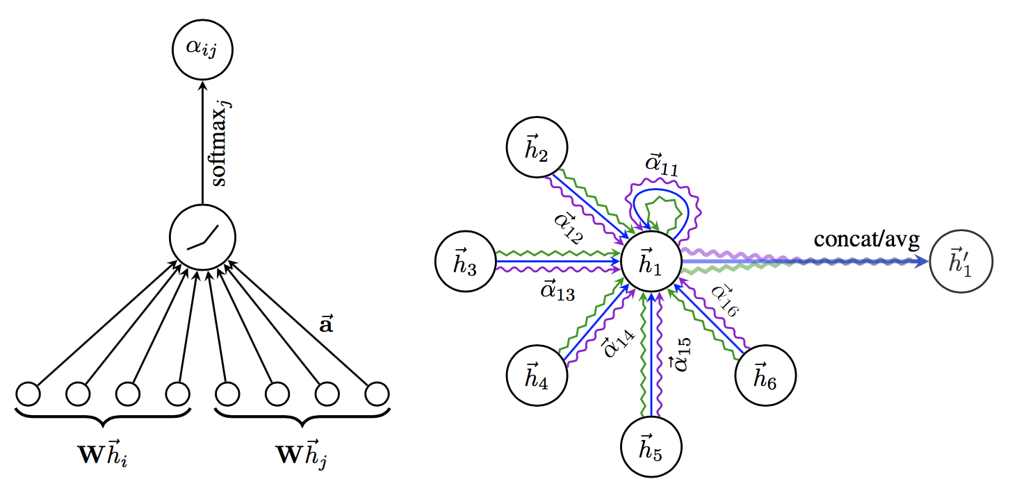
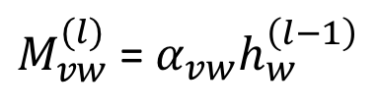
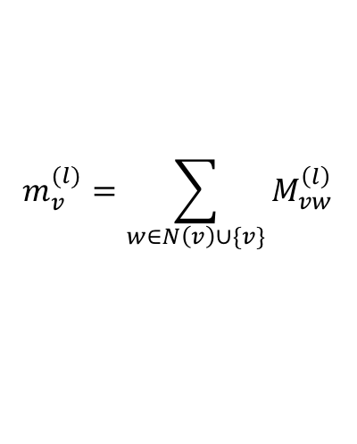
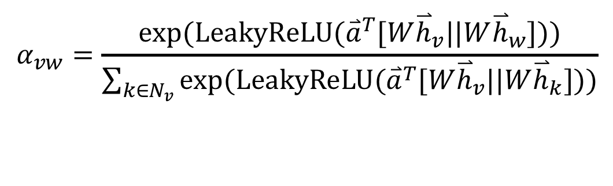
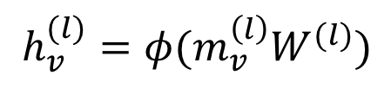
Example 2: Graph attention networks (GAT)
GAT provides weighted sum over the neighborhood—Enables to selectively integrate information.
$M_{vw}^{(l)}$= $α_{vw}h_{w}^{\left(l−1\right)}$
$$m_{v}^{(l)}=\sum_{w∈N\left(v\right)∪\{v\}}{M_{vw}^{\left(l\right)}}$$
$$h_{v}^{(l)}=φ(m_{v}^{\left(l\right)}W^{(l)})$$
$$α_{vw}=\frac{exp⁡(LeakyReLU({\overset{⃑}{a}}^{T}[W{\overset{⃑}{h}}_{v}||W{\overset{⃑}{h}}_{w}]))}{\sum_{k∈N_{v}}{exp⁡(LeakyReLU({\overset{⃑}{a}}^{T}[W{\overset{⃑}{h}}_{v}||W{\overset{⃑}{h}}_{k}]))}}$$

Slide 37
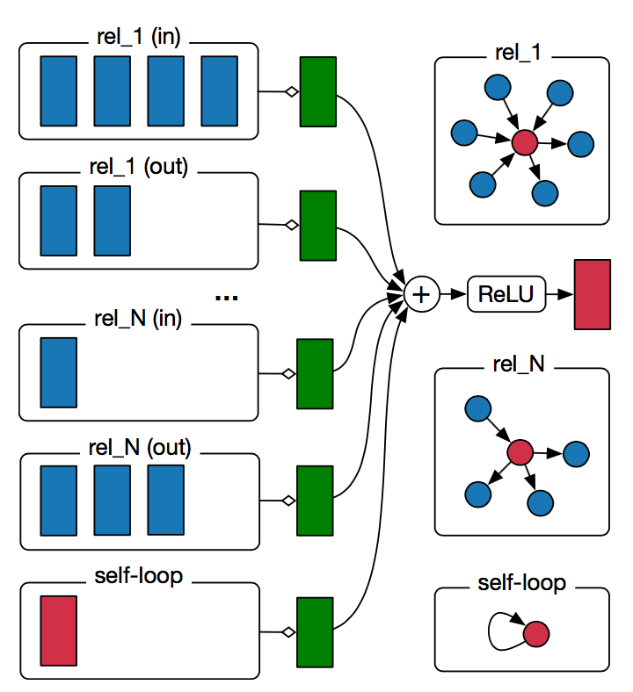
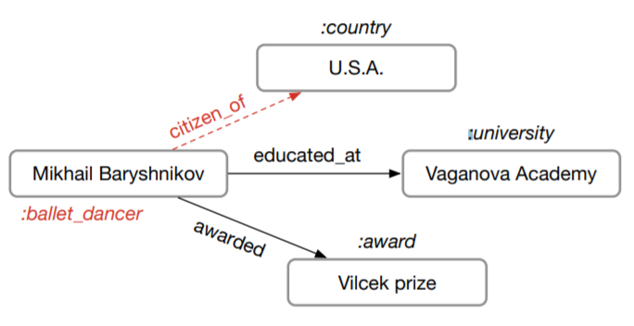
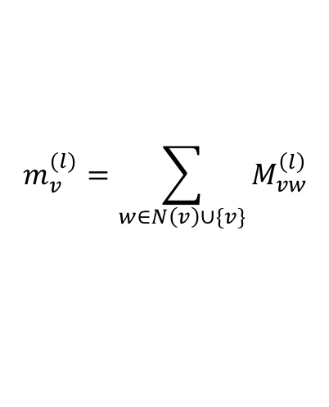
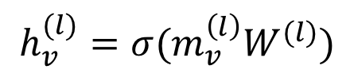
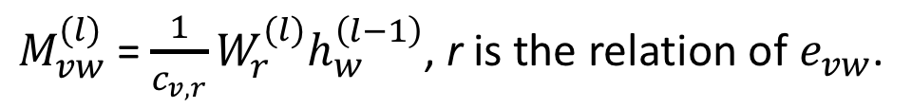
Example 3: Relational graph convolution networks (RGCN)
Handles graphs whose nodes are connected with different relations.
$M_{vw}^{(l)}$= $\frac{1}{c_{v,r}}W_{r}^{(l)}h_{w}^{\left(l−1\right)}$, r is the relation of $e_{vw}$.
$$m_{v}^{(l)}=\sum_{w∈N\left(v\right)∪\{v\}}{M_{vw}^{\left(l\right)}}$$
$$h_{v}^{(l)}=σ(m_{v}^{\left(l\right)}W^{(l)})$$

Slide 38
Graph Representation Learning (GNNs)
Graph Neural Networks (GNNs) extends the well known CNN and RNN on graphs, from Euclidean data to Graphs and Manifolds
RNN-based GNNs:
Graph neural networks (Scarselli et al., 2009)
Gated graph sequence neural networks (GGS-NNs) (Li et al., ICLR 2016)
CNN-based GNNs:
Graph Convolutional Networks (GCN) (Kipf & Welling, ICLR 2017)
Message Passing-based GNNs:
GraphSAGE (Hamilton & Ying & Leskovec, NIPS 2017)
Graph Attention Networks (GAT) (Velickovic et al., ICLR 2018)
MPNN (Gilmer et al., ICML 2017)

Slide 39
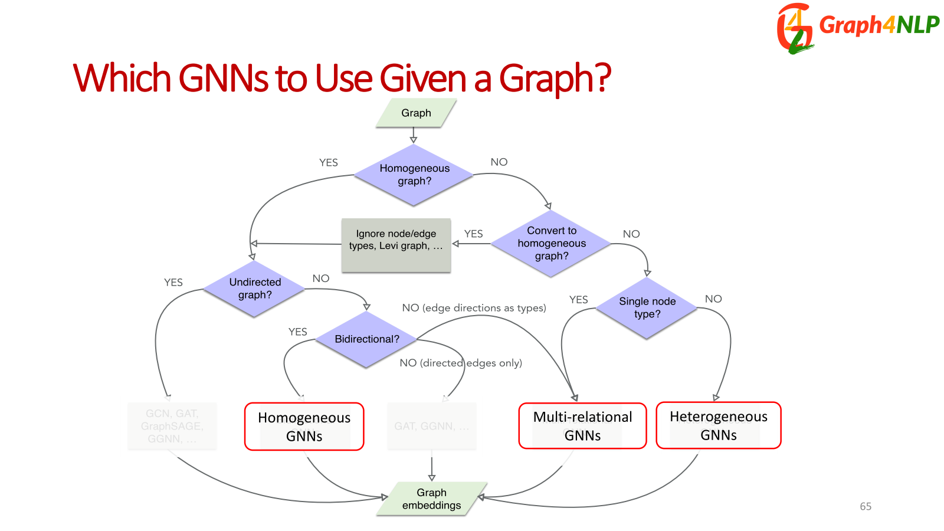

Slide 40
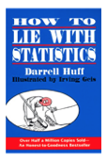
Why are graph neural networks better?
GNNs compute node embeddings using both the structure of the graph and the features of the nodes and edges.
Name: xxx
Age: xxx
Sex: xxx
Title: How to lie with statistics
Author: Darrell Huff
Type: Kindle Edition
Price: $6.91
users
books

Slide 41
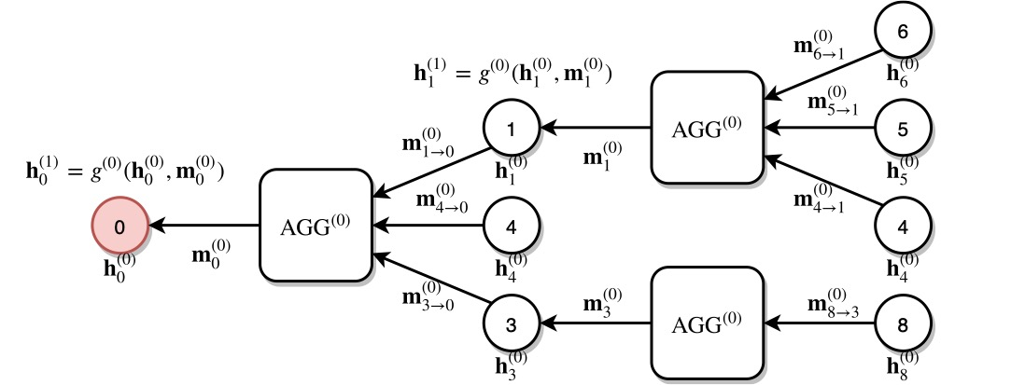
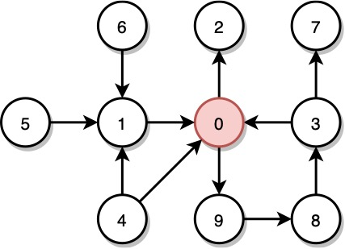
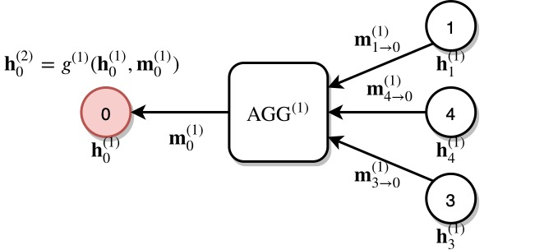
Why are graph neural networks better?
GNNs can integrate topologically distant information in a non-linear fashion.
1st layer
2nd layer

Slide 42
Why are graph neural networks better?
GNNs and the downstream classification/regression models can be trained in an end-to-end fashion.
Traditional method
Classifier
GNN
Classifier

Slide 43
Why are graph neural networks better?
GNNs are naturally inductive because they learn the same neural networks on all the nodes and edges.
GNN
GNN

Slide 44


Slide 45


Slide 46


Slide 47


Slide 48


Slide 49


Slide 50


Slide 51


Slide 52


Slide 53


Slide 54


Slide 55


Slide 56


Slide 57


Slide 58


Slide 59


Slide 60


Slide 61


Slide 62


Slide 63


Slide 64


Slide 65


Slide 66


Slide 67


Slide 68


Slide 69


Slide 70


Slide 71


Slide 72


Slide 73


Slide 74


Slide 75


Slide 76
Summary
The solution to many applications can be formulated as graph learning problems.
Graph neural networks are a new technique for graph learning.
They have multiple advantages over traditional methods.
GNNs are used in multiple graph tasks and can be trained end-to-end

Slide 77
References (Slides primarily borrowed from…)
Overview of Graph Neural Networks - George Karypis
Graph Neural Networks: Models and Applications - Yao Ma, et al
GraphSAGE: Deep Learning for Relational Data - Jure Leskovec
Deep Learning on Graphs in Natural Language Processing and Computer Vision - Lingfei Wu, IBM Research AI
Deep Learning on Graphs for Natural Language Processing - Lingfei Wu, Yu Chen, Heng Ji, and Yunyao Li, NAACL-2021 Tutorial

